Slide 1
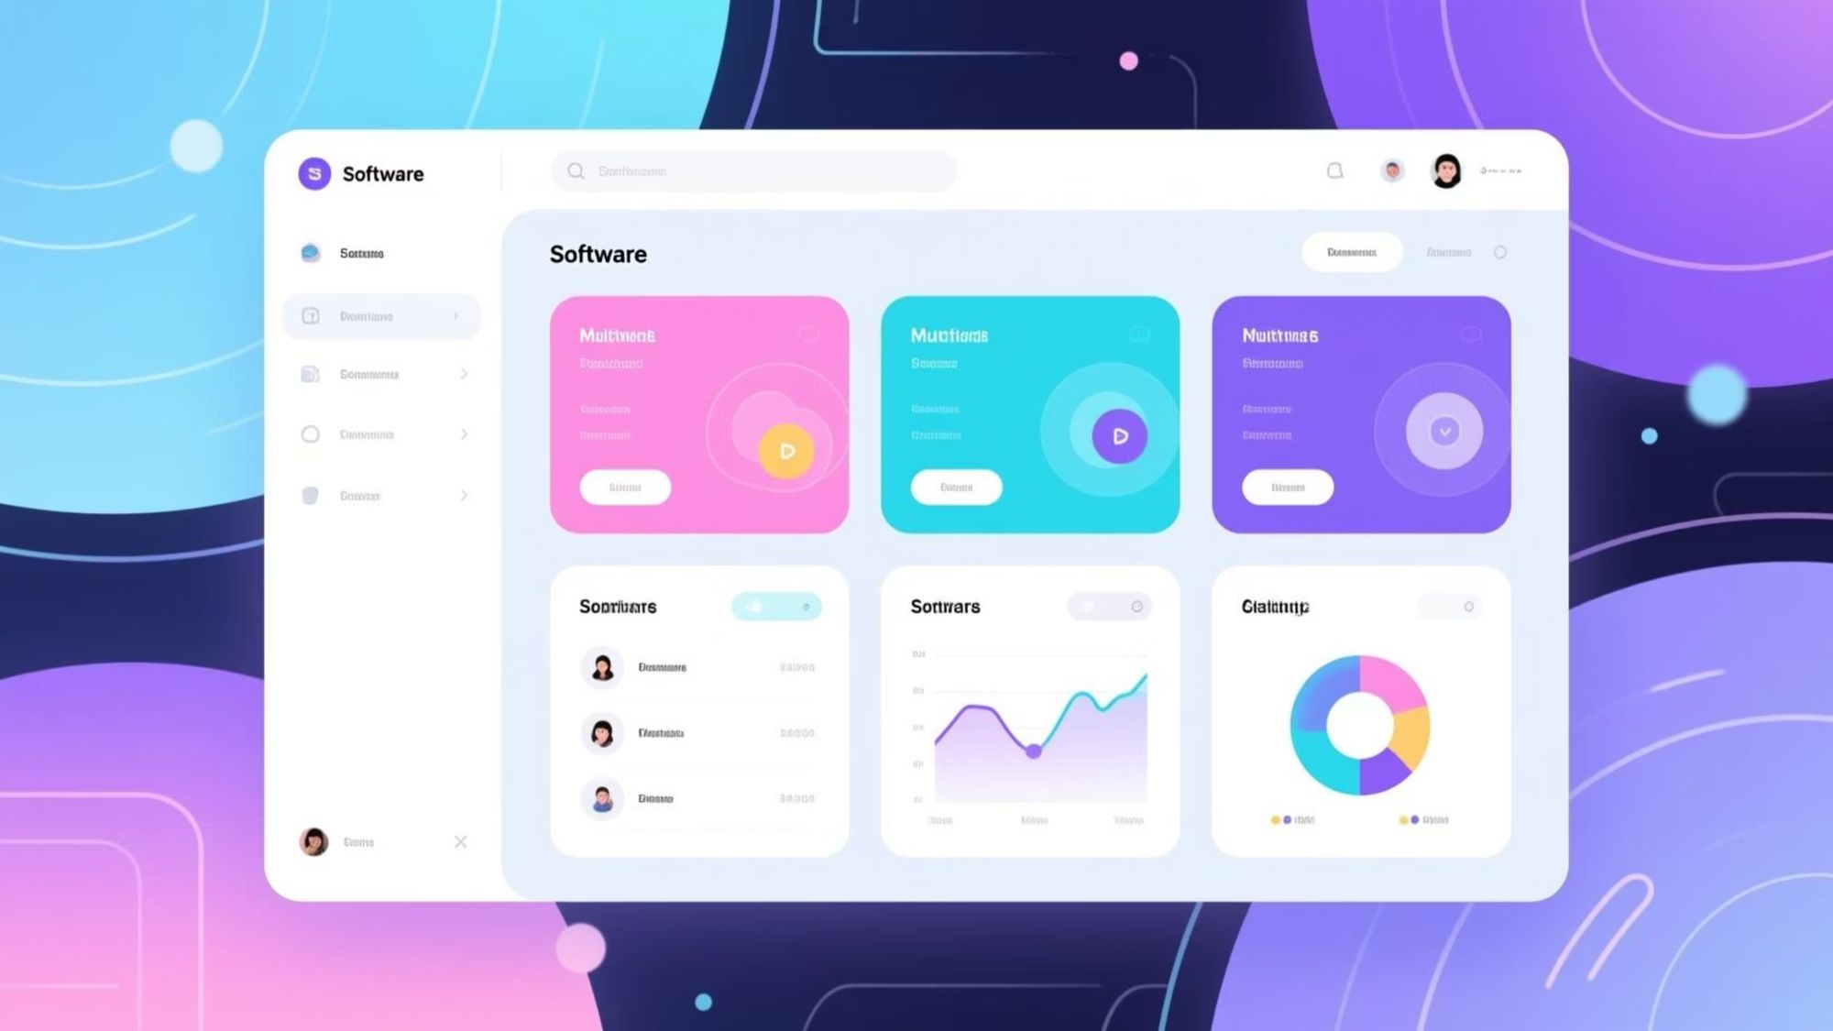
CarCommunity Maintenance Center - Project Documentation
This document is intended for software engineers, DevOps engineers, and technical product managers responsible for building and maintaining the multi-tenant CarCommunity platform (ASP.NET Core + Angular).
The document provides a technical overview, architectural details, and quick-start guidelines to facilitate understanding and work on the project. The platform is designed to provide integrated services for car owners and service providers.

Slide 2

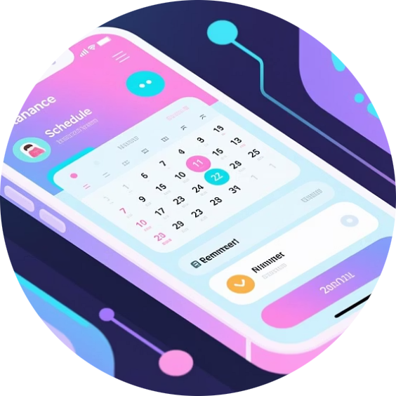

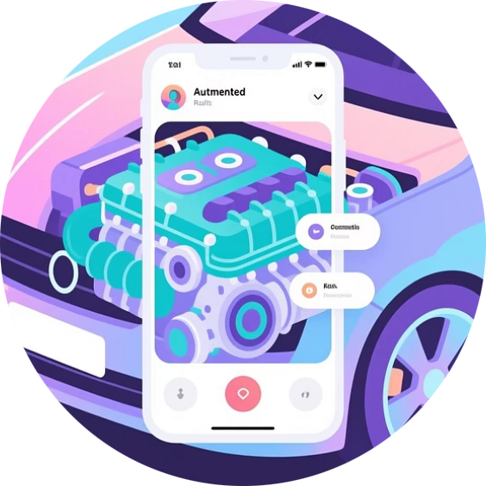
Project Overview and Key Features
The Car Community Maintenance Center is a comprehensive platform that allows car owners, maintenance shops, and spare parts sellers to manage vehicles, schedules, community interactions, and business transactions.
Vehicle Management
Maintenance Scheduling and Reminders
E-Marketplace (Marketplace)
Augmented Reality (AR) Experiences
Registering cars, uploading photos, and viewing detailed maintenance history for each vehicle.
Scheduling services, with automatic reminders via email and SMS.
Buying and selling spare parts, payment via Stripe, and efficient order tracking.
Pointing the phone towards the car to view live diagnostics, maintenance tips, and part details.
The platform features Multi-tenant support where each client gets an isolated subdomain (e.g., {tenant}.mycarcommunity.com), and full support for Dark-Mode and Arabic language (RTL).

Slide 3
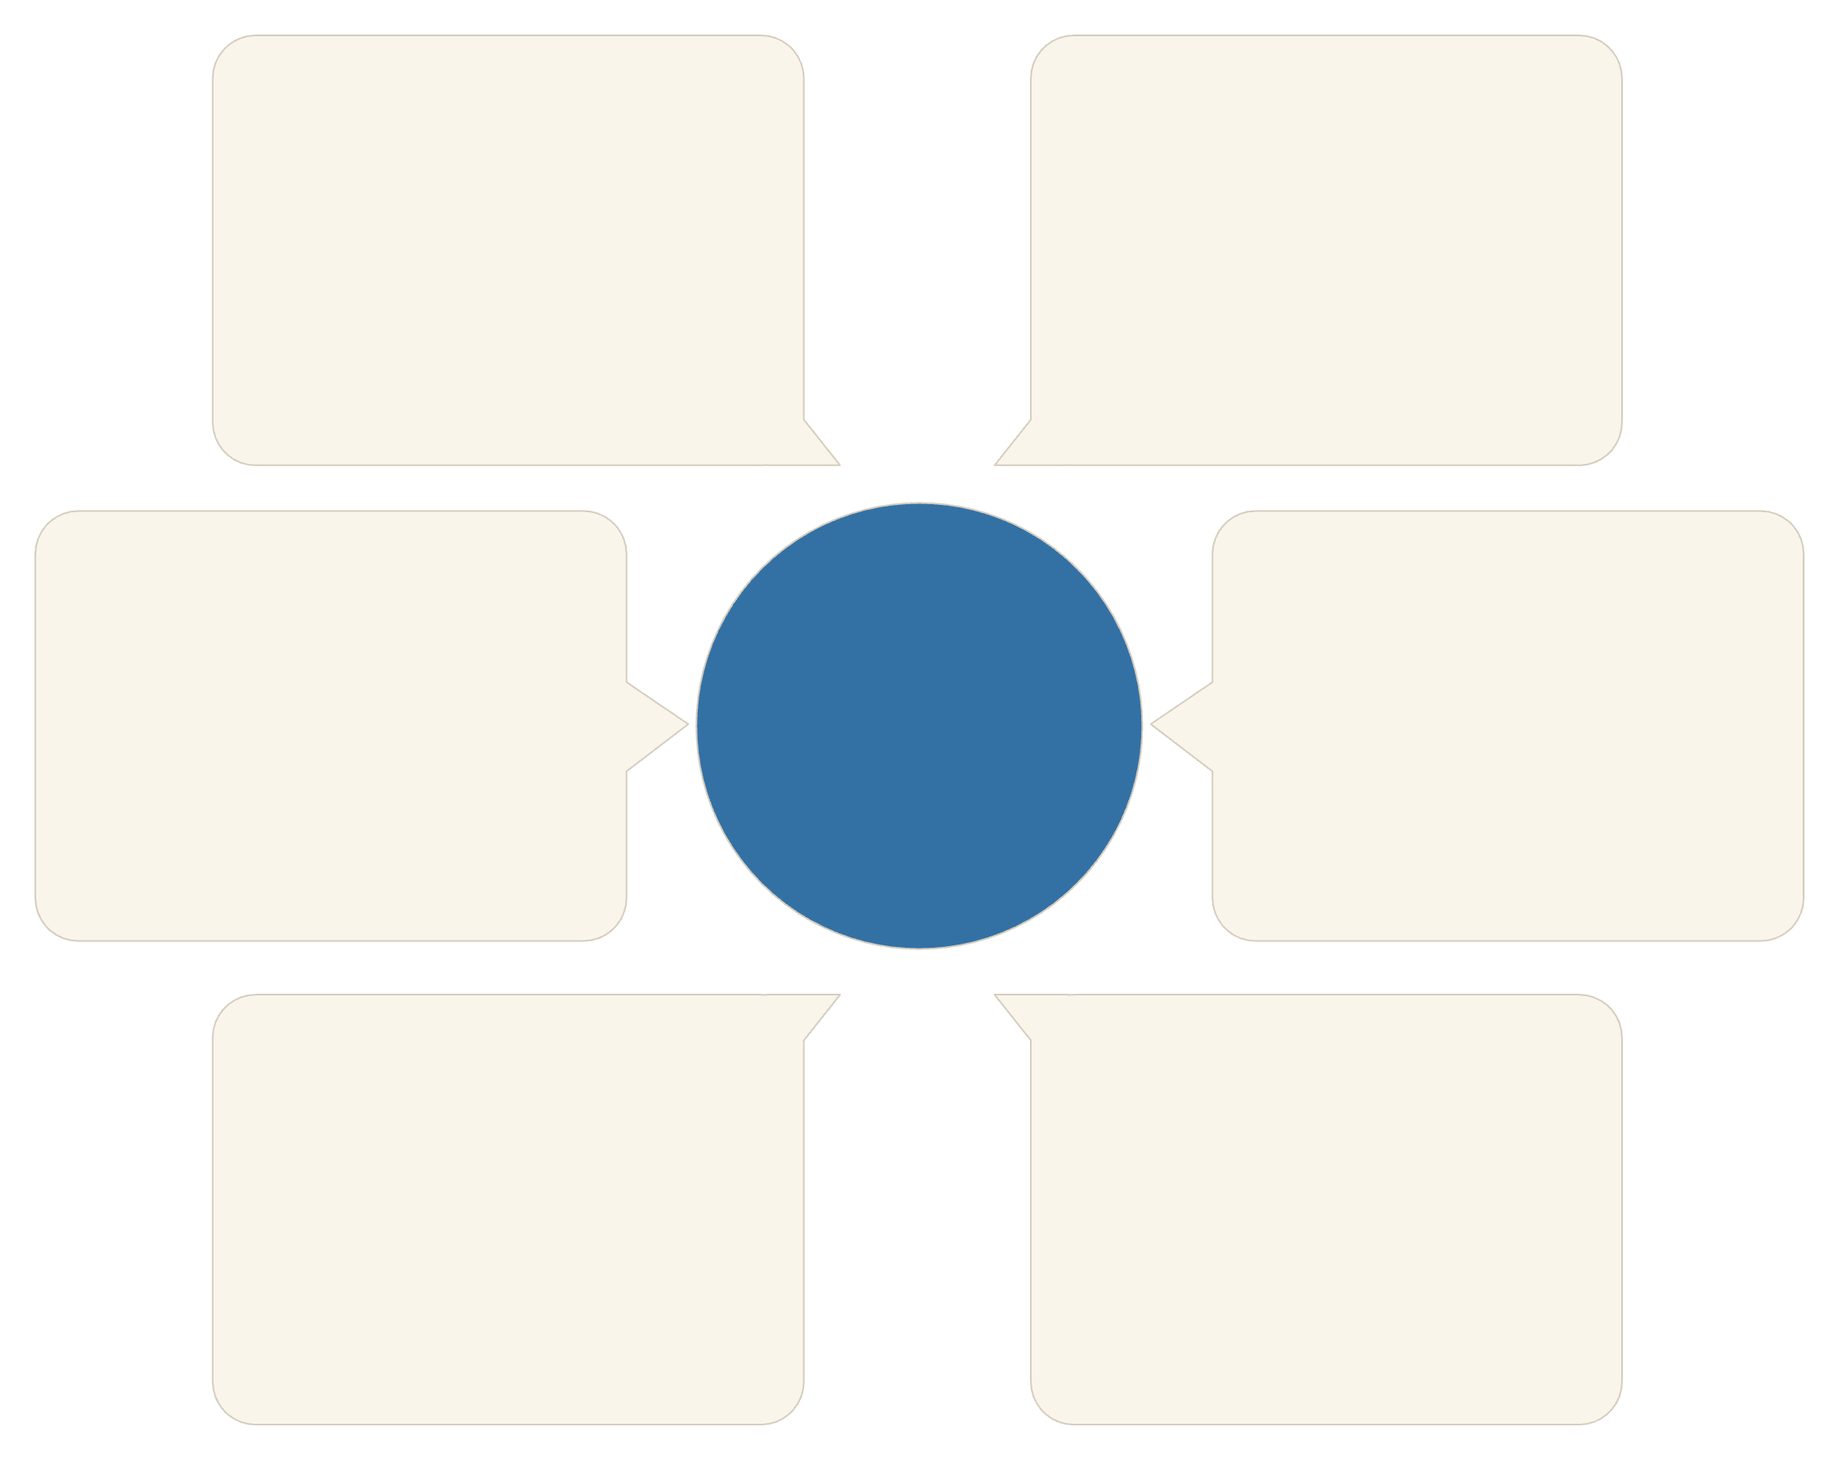
Key Architectural Components
The platform is built on a modern model focusing on scalability and reliability. All services are centered around an API Gateway to ensure security and proper request routing.
Terraform & GitHub Actions
API Gateway
Infrastructure deployment and automated operations
Central point for request routing
Stripe Webhooks
Integration Architecture
SignalR + Redis
Payment notifications to API Gateway
Real-time communication and caching
Hangfire
EF Core Database
Scheduled tasks connecting to the database
Data management and tenant isolation
Tenant Isolation
Data isolation is enforced via a comprehensive filter in EF Core, ensuring that every data query includes the TenantId, thereby protecting the data privacy of each client.
API Gateway (NGINX): TLS termination, request routing, and tenant information extraction.
EF Core: The primary data layer for all entities (Tenants, Users, Cars, ...).
SignalR + Redis: Real-time notifications, chat, and presence status.
Blob Storage: Storing images and Augmented Reality assets.
Hangfire: Background tasks for reminders, usage summaries, and AI suggestions.
Terraform + Helm: For automating infrastructure provisioning and application deployment.
OpenAI: For chat services and community content moderation.
Application Insights / Grafana: For monitoring and metric aggregation.

Slide 4

Prerequisites and Tools
To begin working on the project locally, a specific set of tools must be installed to ensure environment compatibility with ASP.NET Core 9 and Angular 18 requirements.
.NET SDK 9.0
Node.js 20.x LTS
Docker Desktop and Docker Compose v2
Or .NET 8 LTS with TargetFramework modification.
Required to run and build Angular applications.
To run local dependent services (databases, Redis, etc.).
Visual Studio 2022 / VS Code
Terraform 1.9+ and Helm 3.14+
Recommended development environment.
For infrastructure automation and deployment (optional for local work).

Slide 5

Getting Started - Local Setup and Development
Local setup requires an environment file (.env) containing the necessary secret keys to run services like the database, Stripe, and OpenAI, followed by running Docker Compose.
Step 4.3: Build and Run with Docker Compose
The backend (API) runs on port 5000, and the web interface (SPA) on port 4200. SQL Server and Redis databases are automatically provisioned.
Basic running commands:
git clone https://github.com/yourorg/car-community-saas.gitcd car-community-saas# Step 4.3: Build and run servicesdocker compose up -d --build
Check Backend (Swagger): http://localhost:5000/swagger
Check User Interface (SPA): http://localhost:4200
Important Note: You must run docker compose exec api dotnet ef database update only once to apply database migrations on the first run.

Slide 6
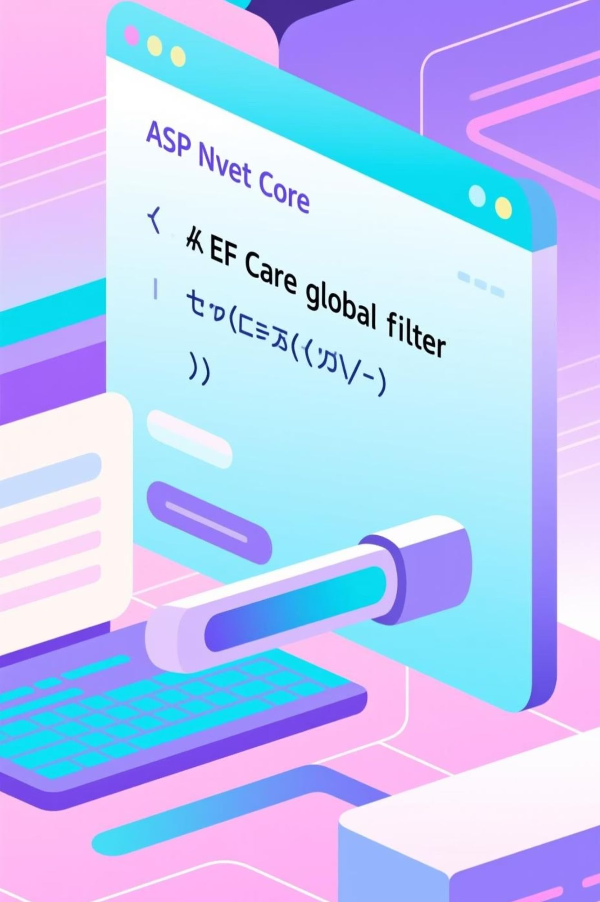
Backend: ASP.NET Core 9
The backend project structure follows a standard pattern, focusing on tenant isolation via ITenantEntity and utilizing EF Core global query filters.
Key concepts governing the backend:
Tenant Isolation
Every data entity includes a TenantId, and a filter is applied to ensure each tenant accesses only their own data: HasQueryFilter(e => EF.Property(e, "TenantId") == GetCurrentTenantId());
Feature Flags Management
The FeatureFlag table defines the features available to each tenant based on their Plan. Templates are copied when a new tenant is provisioned.
Provisioning Service
Responsible for creating the tenant, Stripe customer, admin user, copying initial feature settings, and sending the welcome email.
Real-time Conversations
AiChatHub and HumanChatHub (depending on features) are used with PresenceHub to track user status and send notifications.

Slide 7
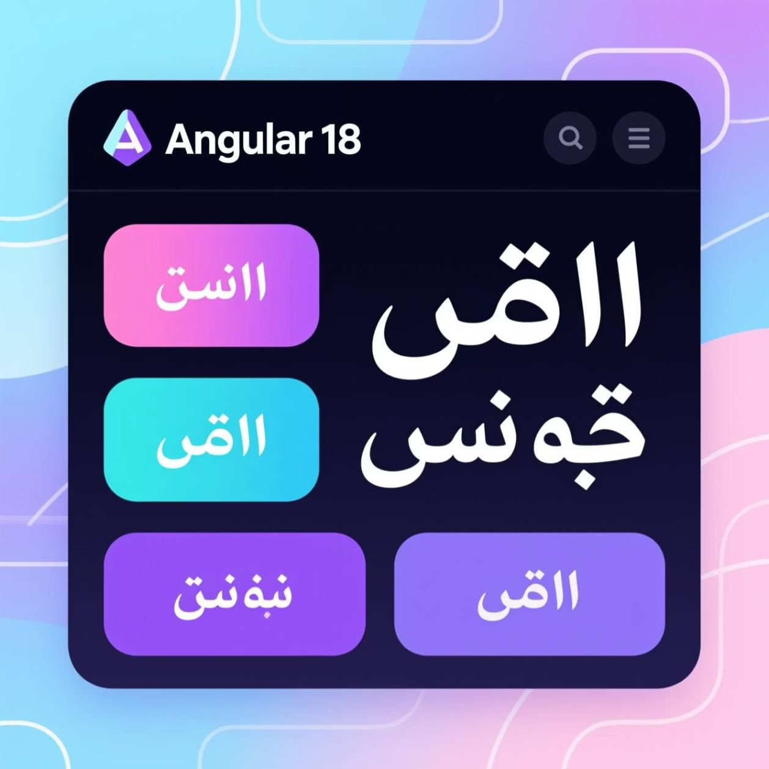
Frontend: Angular 18
The user interface is built using Angular 18 and relies on the NgRx pattern for state management. The interface is designed to support advanced features such as Augmented Reality (AR), multilingualism (RTL with Arabic), and dark mode.
FeatureFlagService service: Queries /api/tenant/flags and exposes the can(key) function to control the visibility of features based on the tenant's plan.
ThemeService service: Toggles light/dark mode and stores the preference locally.
I18nService service: Uses ngx-translate to switch languages and set document.dir to support Right-to-Left (RTL) writing.
ArService service: Manages the WebXR lifecycle and loads GLTF models for Augmented Reality display.
Specific pages such as /chat/human and /ar/car/:id are protected via Guards that verify feature authorization through the FeatureFlagService.
Build command for production: ng build --configuration production

Slide 8




Plans and Invoicing - Stripe Integration
Stripe is used to manage subscriptions and invoicing, ensuring secure and PCI-compliant processing of payment data.
Upgrade/Downgrade
Tenant Provisioning
Update Stripe subscription via BillingController.ChangePlan and update Feature Flags locally.
Create a new Stripe customer for the tenant.
Webhook Processing
Usage Limits
The /api/stripe/webhook endpoint receives notifications from Stripe to process events such as successful payments or subscription deletions.
Usage limits (AI tokens, upload size, concurrent devices) are enforced in the backend Middleware layer.
Example of monthly AI token usage limits: Free 10,000, Pro 100,000, Enterprise 1,000,000.

Slide 9

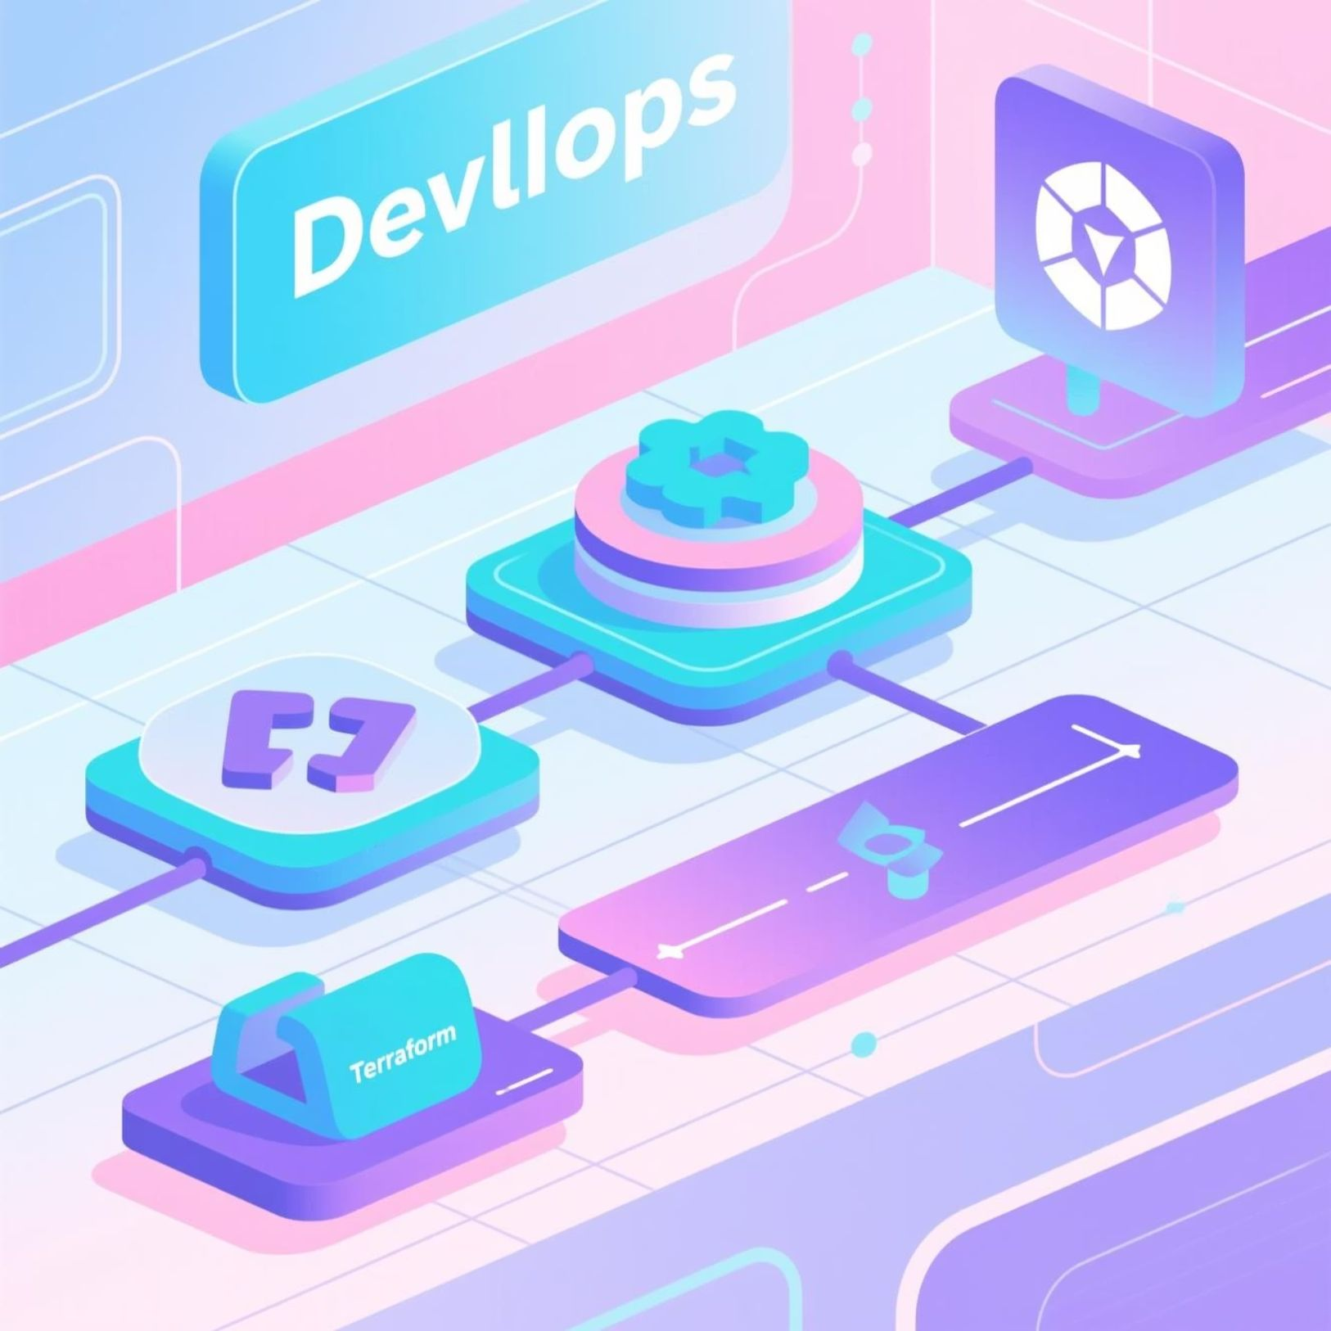



Infrastructure as Code (IaC) and CI/CD
We use Terraform and Helm to manage infrastructure resources and reliable deployment, ensuring identical and repeatable environments.
Terraform and Helm
GitHub Actions Workflow
Terraform is used to provision core cloud resources (Azure AKS, Azure SQL, Key Vault). Helm is used to deploy API and SPA applications, with reference management for secrets.
Build, test, and deployment are automated via GitHub Actions workflows, ensuring consistent deployment when merging changes or creating Release Tags.
Provisioning a resource group (AKS, Azure SQL, ACR, Front Door).
Workflow Stages:
Embedding secret references from Key Vault into Helm values.
Core commands: terraform apply and helm upgrade --install
Build and Test
Build Docker Images
Push Images
Helm Update (Deployment)

Slide 10
Monitoring, Logging, and Security
Comprehensive monitoring and robust security measures are essential for a multi-tenant SaaS platform. We use an integrated suite of tools to ensure visibility and compliance.
Monitoring & Metrics
Structured Logging
We use Application Insights for tracing and telemetry, along with Prometheus and Grafana for metrics and custom dashboards.
Serilog logs are directed to Seq/Elastic, with logs enriched with TenantId and UserId for easy traceability.
Security & Compliance
Alerting
Short-lived JWT authentication, role-based authorization (RBAC) and feature flags, per-tenant/IP rate limiting, and PCI/GDPR compliance through no card data storage and automated scanning.
Azure Monitor alerts are configured to detect high error rates, Hangfire job failures, and service health issues via the /healthz endpoint.
To ensure security, sensitive secrets are stored in Azure Key Vault, TDE is applied to Azure SQL, and TLS everywhere is enforced via Front Door.

